Slide 1



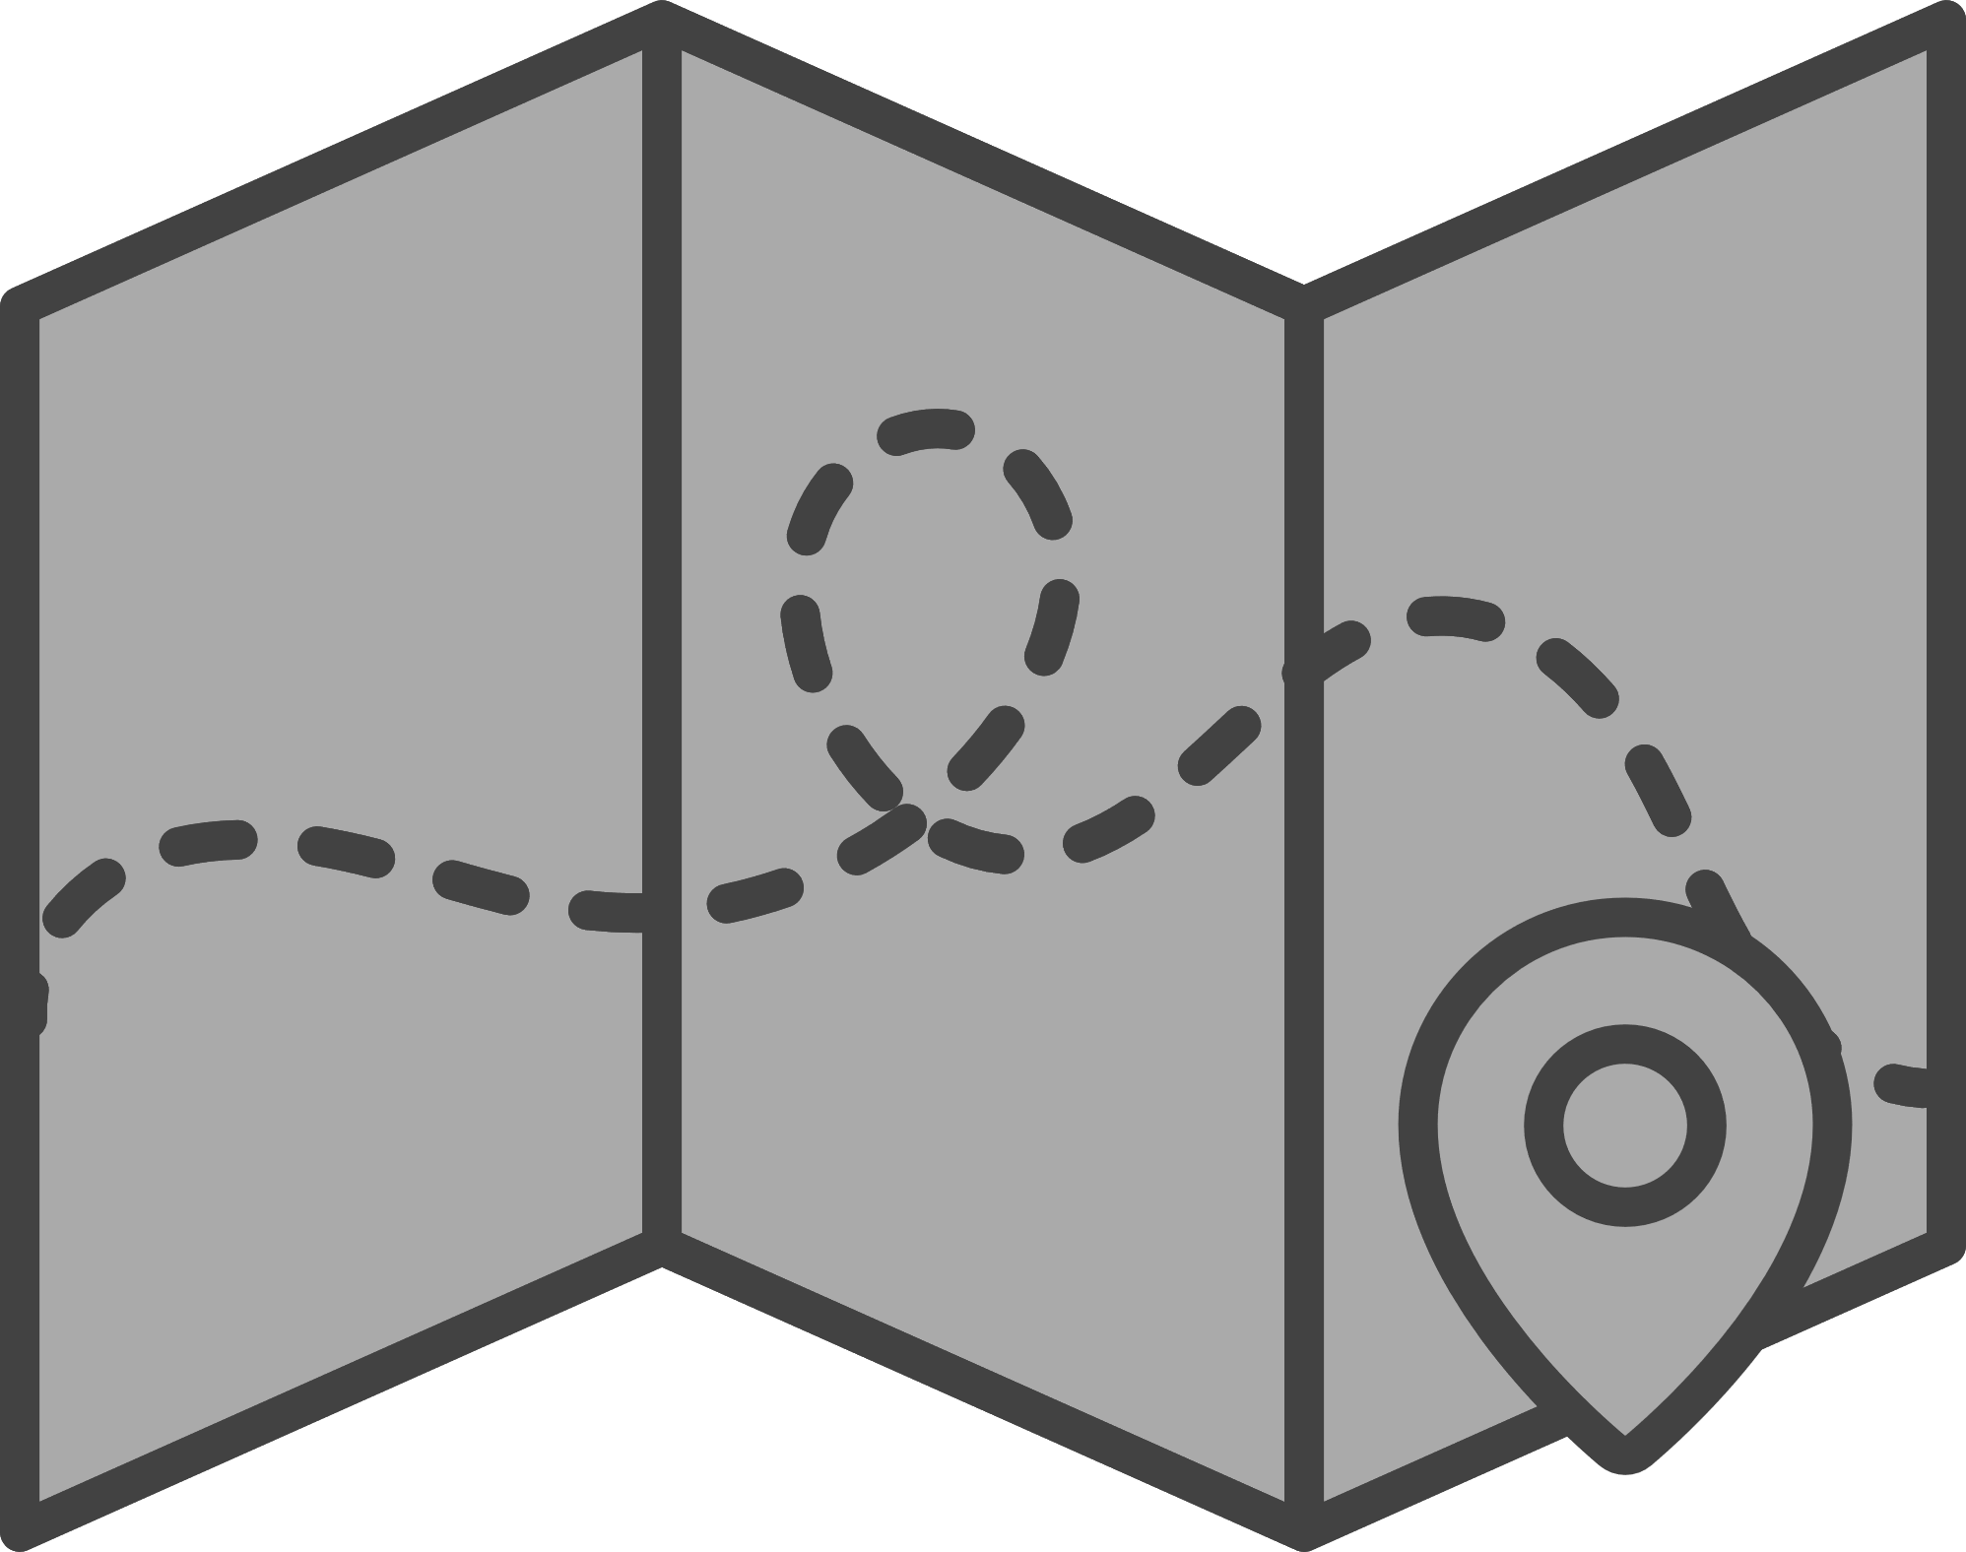
EGY ROUTES
ID | Name
20216083 | Mohamed elyousfy
20216065 | Ali Amr Moussa
20216002 | Ahmed Ashraf
20216086 | Mohamed Shawky
20206058 | Mohamed ibrahim

Slide 2
What is EgyRoutes?
About EgyRoutes:
Smart Map-Based Mobile Application:
Designed to optimize microbus transportation in urban areas.
Leverages user suggestions and advanced pathfinding algorithms.
User Benefits:
Helps commuters, tourists, and city residents find reliable and efficient microbus routes.
Provides real-time tracking and updates.
Incorporates user feedback to continuously improve route accuracy and reliability.

Slide 3
EgyRoutes overall Aim
Enhances the overall commuting experience.
Offers a user-driven solution for navigating microbus routes effectively.
Target Audience
Commuters who rely on microbuses for daily transportation within urban areas.
Anyone looking for efficient and cost-effective transportation solutions
within specific routes or regions.

Slide 4





Project Idea
Map app charts microbus routes, user input, efficient pathfinding algorithm.
App improves microbus routes using user input and real-time data.
Users input start and end points, get optimized microbus routes, track progress, and give feedback.
Create reliable, user-friendly microbus navigation tool for commuters and tourists.

Slide 5
Color schema
Main background color
#d3d3d3
Header, navbar, buttons
#009EFF
Fonts
#000000

Slide 6
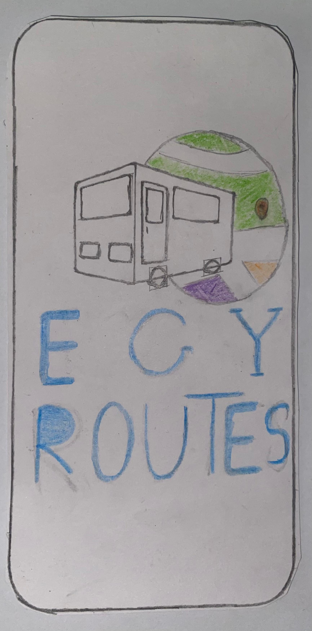
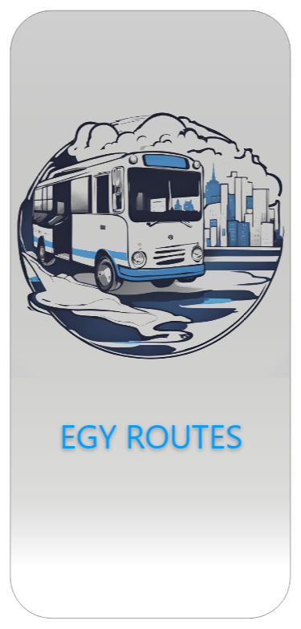
Sketches
Logo
BEFORE :
AFTER :

Slide 7
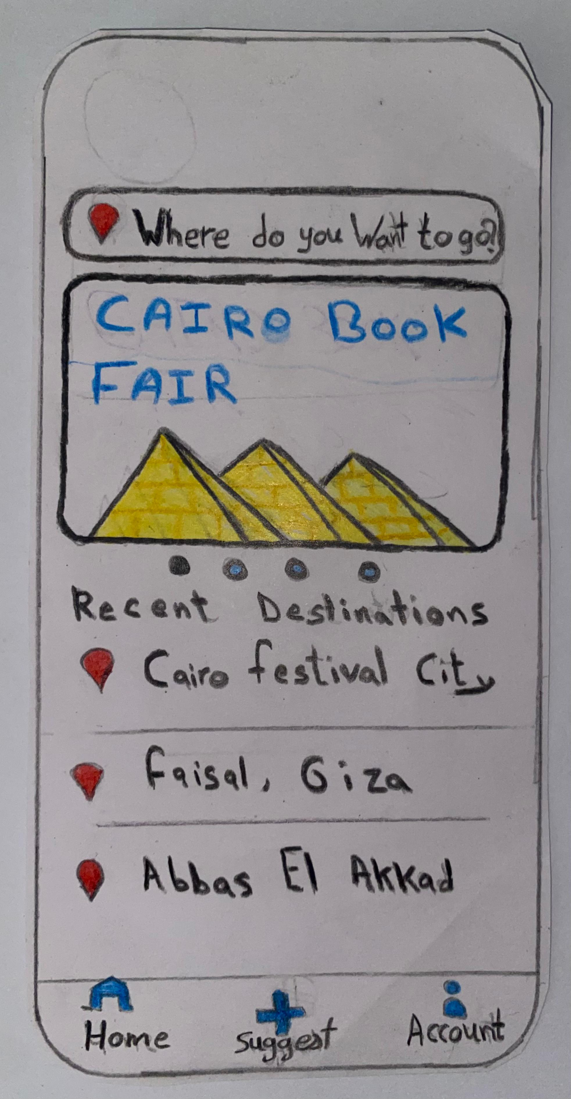
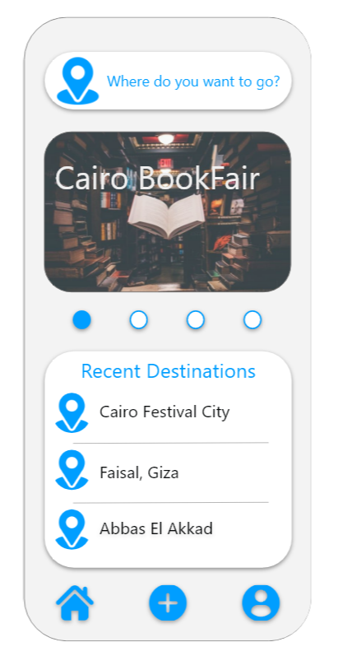
Sketches
Home
BEFORE :
AFTER :

Slide 8
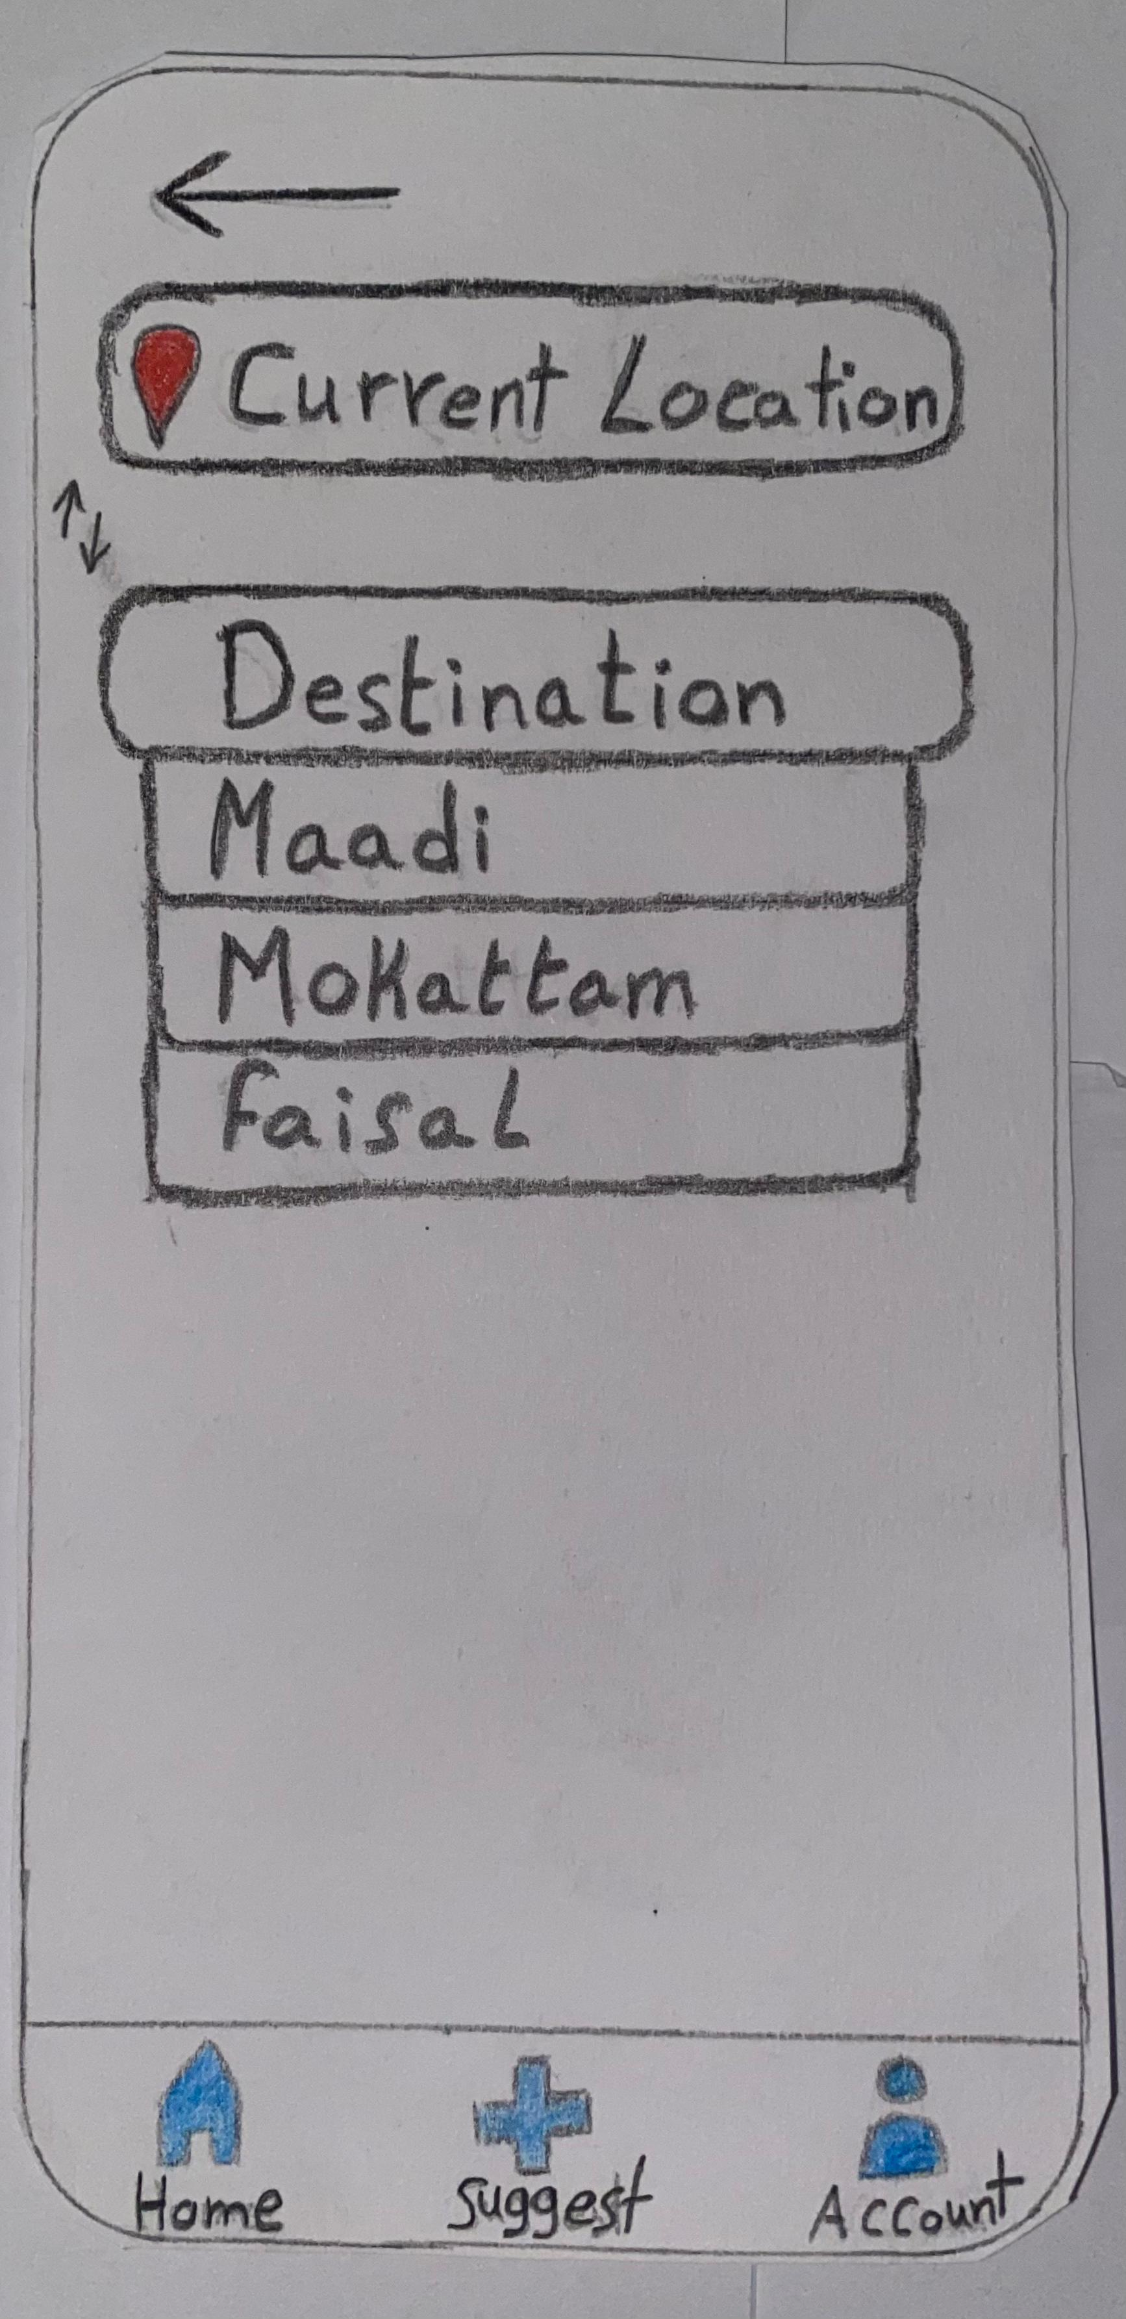
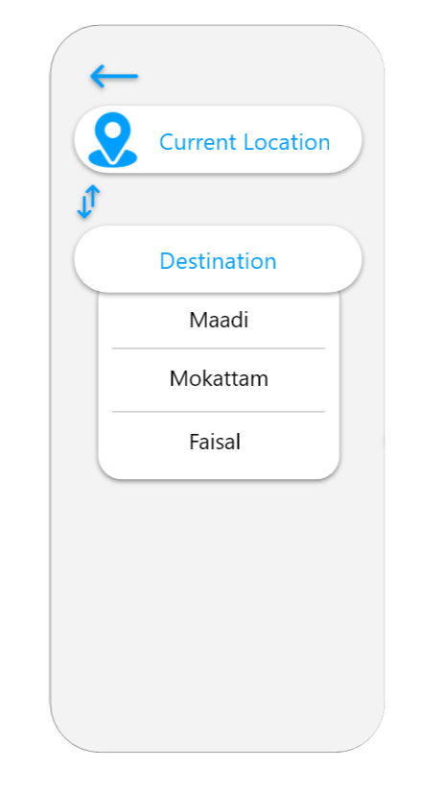
Sketches
Search
BEFORE :
AFTER :

Slide 9
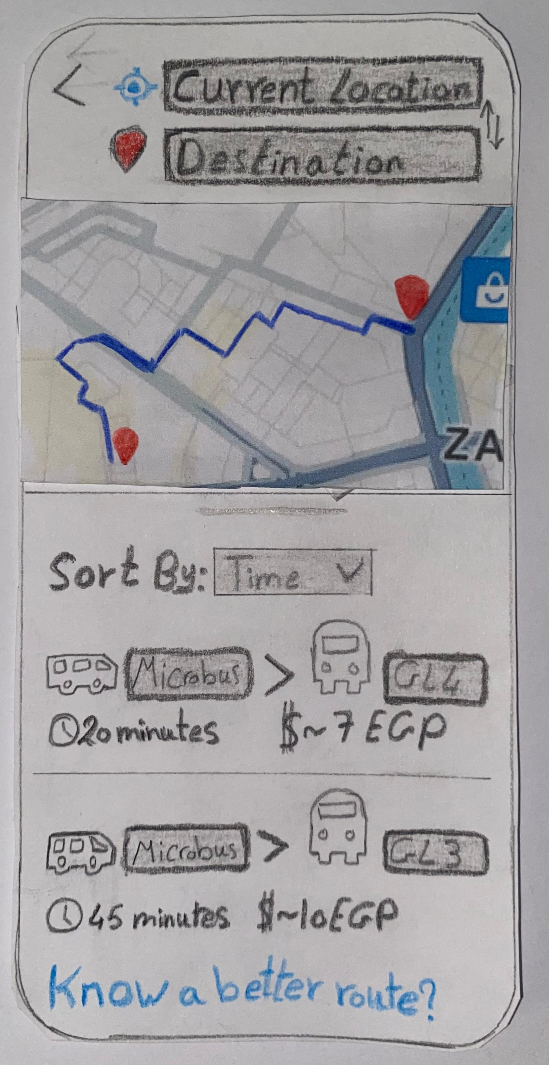
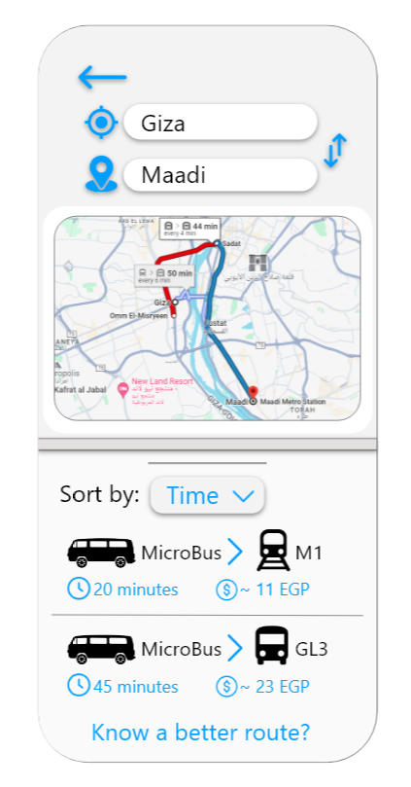
Sketches
Routes view
BEFORE :
AFTER :

Slide 10
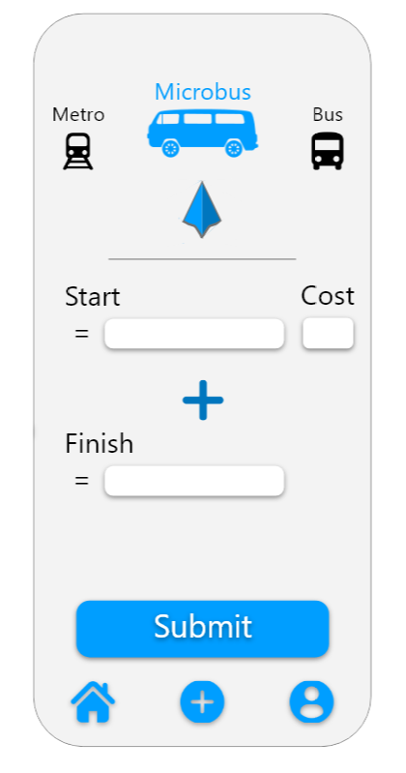
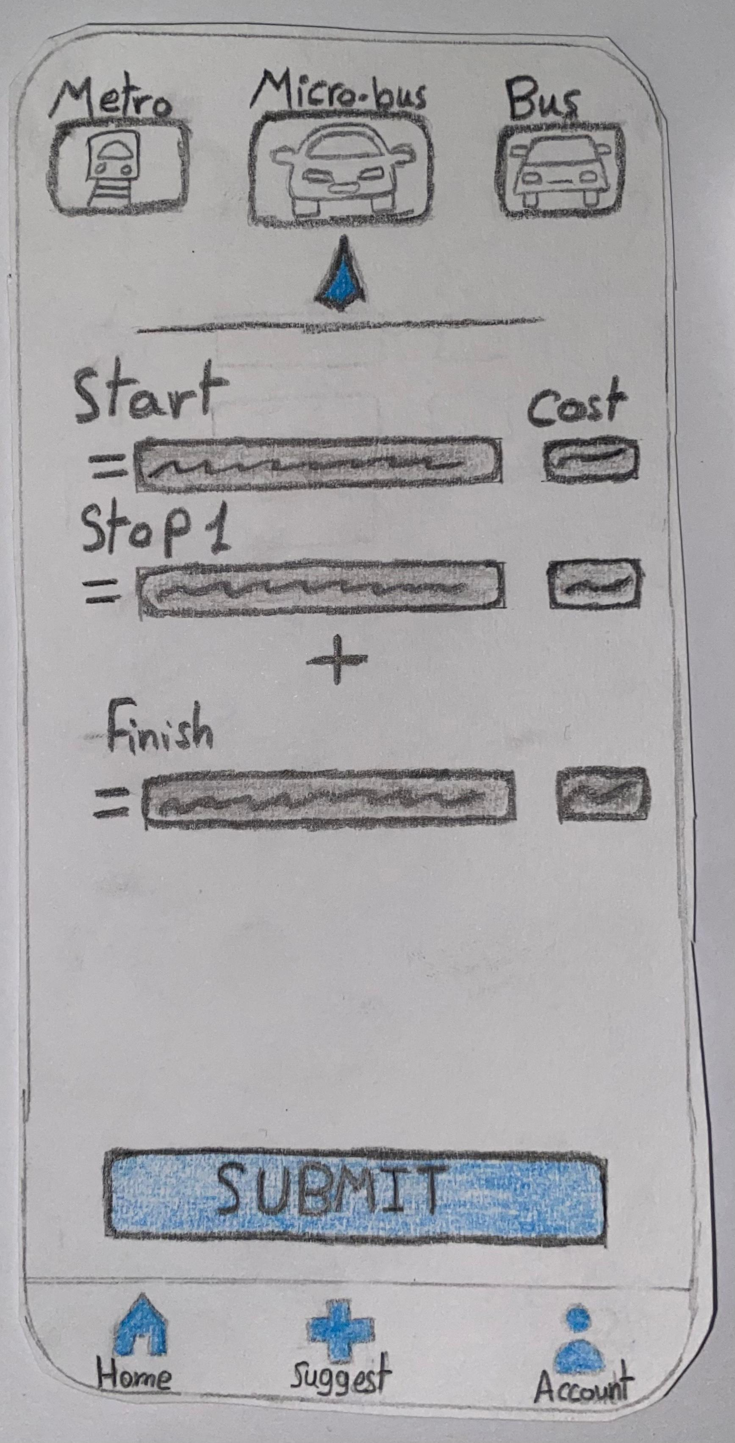
Sketches
Suggest
BEFORE :
AFTER :

Slide 11
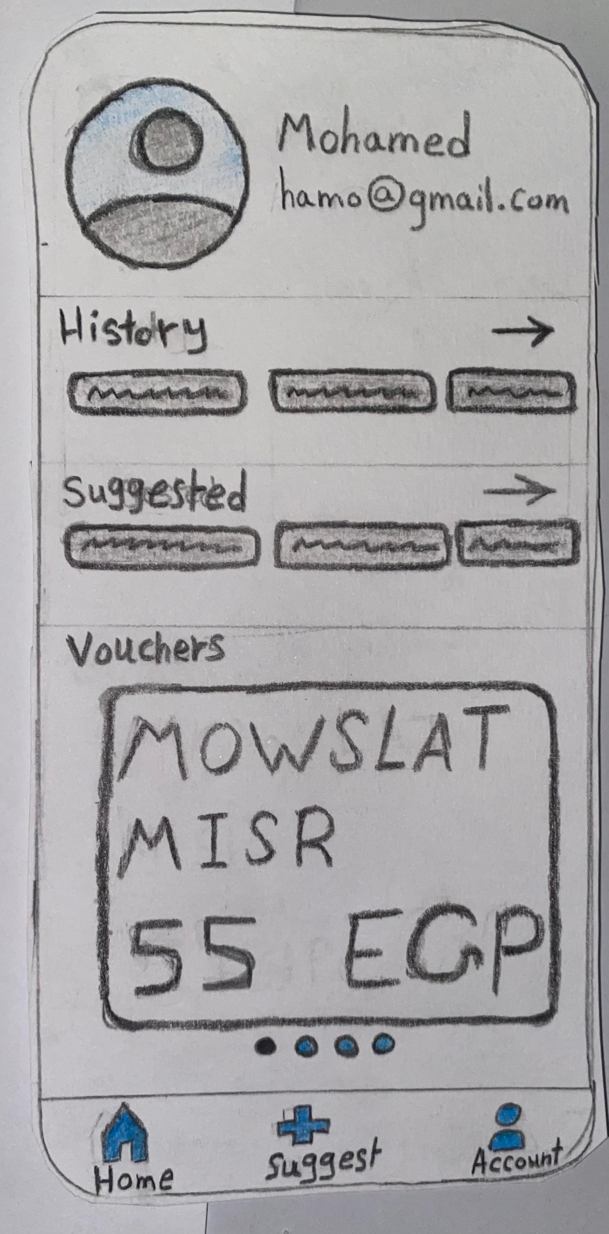
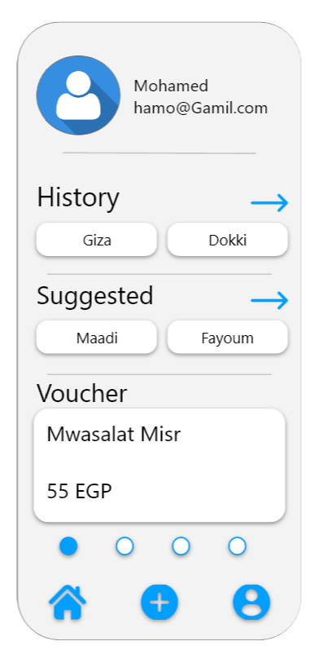
Sketches
Account
BEFORE :
AFTER :

Slide 12
Visual hierarchy principles applied
Size and Color Contrast:
Important elements are highlighted through larger sizes and contrasting colors.
Ensures dominant features naturally draw the viewer's eye.
Positioning :
Critical elements are centered for prominence.
Enhances visibility and focus.

Slide 13
Visual hierarchy principles applied
We used ( Z-Pattern Layout ) :
Top of the Screen:
Search Bar : Positioned prominently at the top.
Middle of the Screen:
Event Ad : Large and visually engaging, draws attention diagonally downward.
Bottom of the Screen:
Recent Destinations List : Easy to find and read.
Navigation Icons: Positioned at the bottom, following the natural reading order.

Slide 14
Visual hierarchy principles applied
Navigation Buttons:
Home: Guides users to the homepage.
Account: Directs users to their account details.
Suggest a Route: Highlighted with bright colors and larger sizes for easy access.
Guides users to different sections intuitively and effectively.

Slide 15
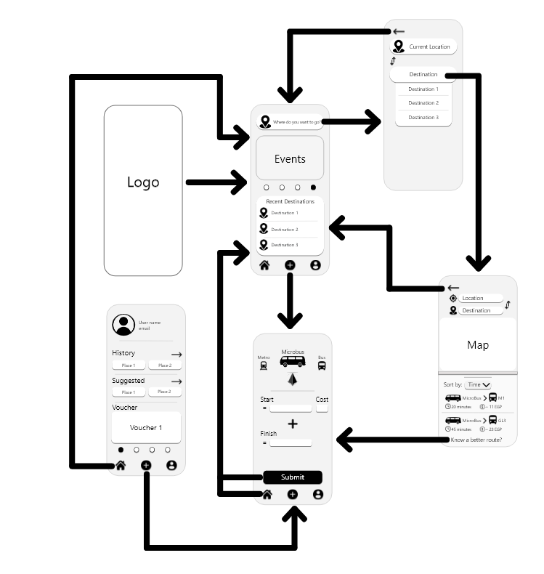
Wire Frame

Slide 16
Application Prototype Video
BEFORE :
https://drive.google.com/file/d/1LSNBEx-QWNYNaY0JygyYVW_Wy3JDMjP4/view?usp=sharing
AFTER :
The recorded video of the prototype interactivity :
https://drive.google.com/file/d/1IWaWqoysAXvuTboabSN0WD_AEEcmx51S/view?usp=sharing
Explaining functionality with voiceover :
https://drive.google.com/file/d/1UUGWevmddxMf9xrp90VHwegNWwH1wIP9/view?usp=sharing

Slide 17
Conclusion!
In conclusion, our map-based microbus route mapping application offers a user-centric solution for efficient and reliable microbus navigation. By leveraging user suggestions, real-time data, and robust pathfinding algorithms, we provide commuters, tourists, and city residents with a valuable tool for optimizing their transportation experiences, saving time, and enhancing overall travel convenience. Our emphasis on design, user experience, feedback mechanisms, and continuous improvement underscores our commitment to delivering a high-quality and impactful mobile application for urban commuters.

Slide 18

Thank You!
Every thing is here : https://drive.google.com/drive/folders/1Dpf9GmfQMafM0lbCK2HnLoEJP_z2bPc0?usp=sharing

